Slide 1
Human in the loop in reinforcement learning for de novo molecular design
Research project in MACADAMIA (CS-E4875)
Nguyen Xuan Binh - 887799
Advisors: Yasmine Nahal, professor Samuel Kaski
Aalto University – 13/07/2024

Slide 2
Table of Contents
State of the art
Research motivation
REINVENT software
Three feedback mechanisms
HITL workflow
Results
Discussion
Conclusion
References

Slide 3
1. State of the art HITL ML for de novo drug design

Slide 4
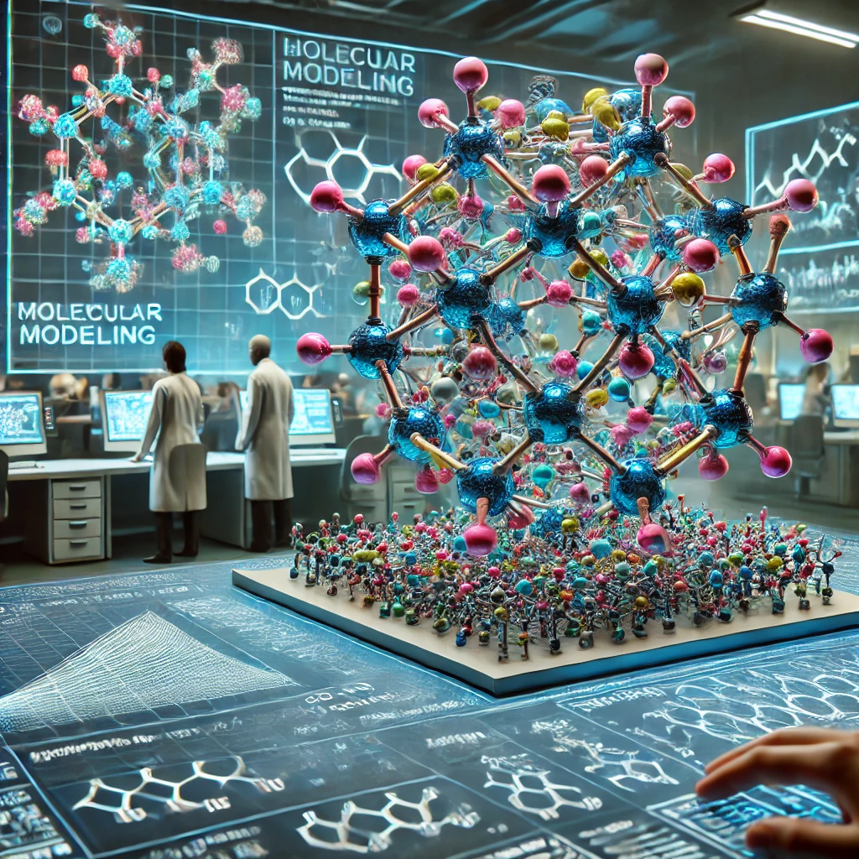
De-Novo Molecular Design
The term "de novo" is Latin for "from the beginning"
It is the process of creating new molecular structures from scratch, guided by computational methods and without relying on existing molecular templates.
The process typically involves the use of algorithms to explore chemical space, generating and optimizing new molecules based on predefined criteria such as biological activity, drug-likeness, and synthesizability.
For instance, Gillet (2000) discusses the application of evolutionary algorithms in de novo molecular design, highlighting their utility in pharmacophore mapping and receptor modeling to generate drug-like compounds from vast chemical spaces.
Similarly, Hsu et al. (2019) present a new data structure for computational molecular design, which builds comprehensive library of new molecules by enabling various molecular operations at atomic resolution
De-Novo Molecular design
Source: DALL-E
Notes:
V. Gillet, De Novo Molecular Design, vol. 4. 2000
H.-H. Hsu, C.-H. Huang, and S.-T. Lin, “New data structure for computational molecular design with atomic or fragment resolution,” Journal of Chemical Information and Modeling, vol. 59, no. 8, pp. 3325–3335, 2019

Slide 5
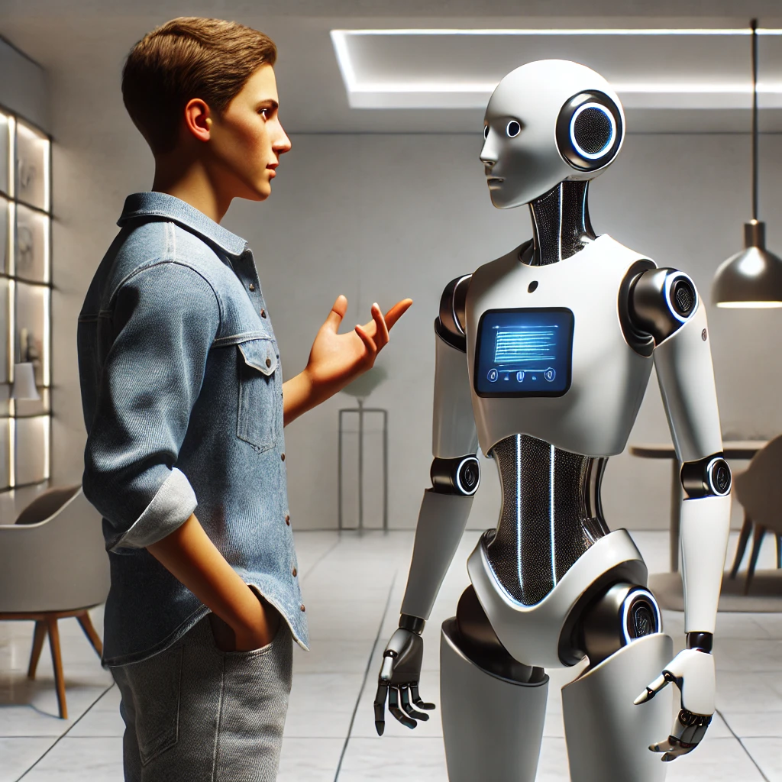
Human-in-the-loop De-Novo molecular design
The 'human-in-the-loop' framework allows humans to use their domain expertise into modeling process, connecting computer and cognitive science (Tharwat et al. 2023)
Reinforcement learning from human feedback (RLHF) introduces a critical human-in-the-loop component to let humans define the objective (Kaufmann et al. 2023)
Some notable works of HITL de-novo molecular design for motivation
🤖 Chemical space-based de novo design method allows researchers to specify desired features and explore across the huge chemical space to discover interesting molecules (Takeda et al. 2016)
🤖 DrugMint, a website that predicts and designs drug-like molecules, uses predictive models to help scientists identify compounds with high drug-likeness scores (Dhanda et al. 2013)
🤖 DrugChat, a platform that uses graph neural networks and massive language models to provide feedback and ideas, enables users to query and revise chemical designs interactively (Liang et al. 2023)
An expert human provides his
expertise domain to the AI agent
Source: DALL-E
Notes:
A. Tharwat and W. Schenck, “A survey on active learning: State-of-the-art, practical challenges and research directions,” Mathematics, vol. 11, no. 4, 2023.
T. Kaufmann, P. Weng, V. Bengs, and E. Hüllermeier, “A survey of reinforcement learning from human feedback,” 2023.
S. Takeda, H. Kaneko, and K. Funatsu, “Chemical-space-based de novo design method to generate drug-like molecules,” Journal of Chemical Information and Modeling, vol. 56, no. 9, pp. 1667–1681, 2016.
S. K. Dhanda, D. Singla, A. Mondal, and G. Raghava, “Drugmint: a webserver for predicting and designing of drug-like molecules,” Biology Direct, vol. 8, p. 28, 2013.
Y. Liang, R. Zhang, L. Zhang, and P. Xie, “Drugchat: Towards enabling chatgpt-like capabilities on drug molecule graphs,” arXiv preprint arXiv:2309.03907, 2023.

Slide 6

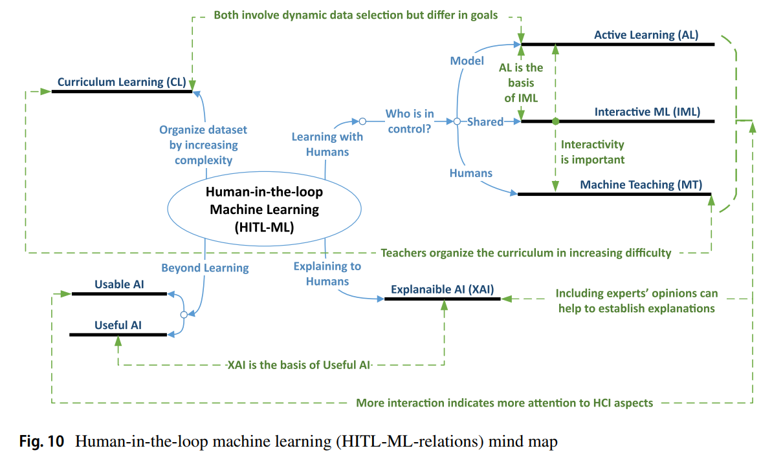
Where is this research project’s domain on this chart?
The ML model is in control, actively querying new molecules for labelling by humans
The scoring ML model directly learns DRD2 probability and have explainable feedback to generative models
Human-in-the-loop machine learning (HITL-ML-relations) mind map (Mosqueira-Rey et al. 2022)
Notes:
E. Mosqueira-Rey, E. Hernández-Pereira, D. Alonso-Ríos, J. Bobes-Bascarán, and Fernández-Leal, “Human-in-the-loop machine learning: a state of the art,” Artificial Intelligence Review, vol. 56, 08 2022.

Slide 7
2. Research project objective

Slide 8
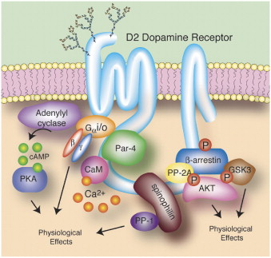
DRD2: Dopamine Receptor D2
General objective: use REINVENT to generate molecules that has dopamine receptor D2 (DRD2). Receptors are proteins found on the surface of cells that receive signals from other chemicals
This receptor is crucial to regulating dopamine, a neurotransmitter associated with motor control, motivation, and reward mechanisms (Zhang et al. 2022)
Optimizing presence of DRD2 could provide improvements to inhibit diseases such as schizophrenia, Parkinson's disease, and drug addiction => DRD2 is highly important for targeting in de-novo molecular design for theurapeutic use
Image Source: Decoding Dopamine Signaling
James A.Bibb
Notes:
W. Zhang, M. Lei, Q. Wen, D. Zhang, G. Qin, J. Zhou, and L. Chen, “Dopamine receptor D2 regulates glua1-containing ampa receptor trafficking and central sensitization through the pi3k signaling pathway in a male rat model of chronic migraine,” Journal of Headache and Pain, vol. 23, no. 1, p. 45, 2022

Slide 9
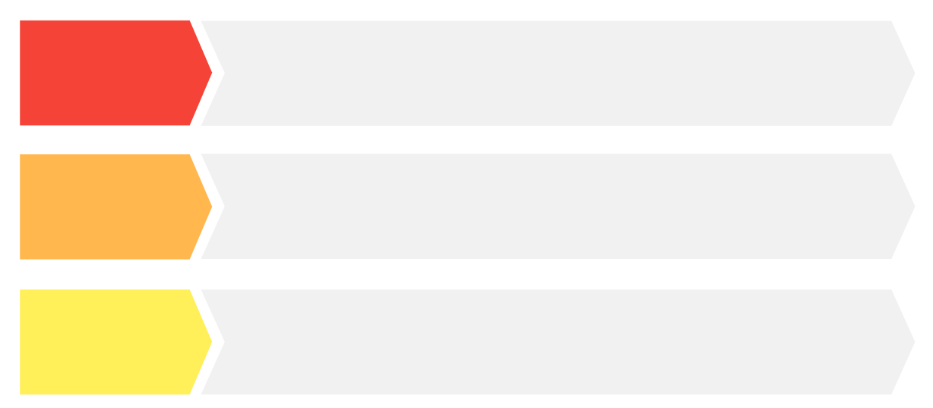

Research project objectives
Objective 1:
De Novo
molcular design
Primary motivation: Use REINVENT to generate molecules that not only have high DRD2 probability but are also novel, diverse and have drug-like properties via 3 feedback mechanisms: scoring, comparing and ranking
Objective 2:
Human-in-the-loop workflow
Establish a human-in-the-loop (HITL) workflow,
which involves human expertise (Oracle) to guide
the molecular design process and 3 acquisition functions
Objective 3:
Build ML model for DRD2 classification
Develop a surrogate ML model that predicts DRD2 probability for novel molecules. Not of major importance because there is already the Oracle

Slide 10
3. REINVENT: generative RL model

Slide 11

: a brief look
REINVENT is an advanced AI tool designed for de novo drug design, providing a comprehensive platform for generating novel drug-like molecules (Blaschke et al. 2020)
Primary motivation: efficiently explore vast chemical spaces, identifying molecules with desired biological activities and drug-like properties.
Users define the initial set of constraints and desired properties to optimize. This may include diversity filter, inception, chemical properties, configurations and most importantly, the scoring function. All of these settings are written to a json file, which would be read by REINVENT input.py
Generated molecules are scored based on the scoring function (or the feedback function). REINVENT tries to generate molecules that maximize the scores
The tool refines the molecules through multiple steps, and finally return SMILES in the scaffold_memory.csv file
No actual generative RL developed by author since it is an algorithm used by REINVENT already
Notes:
T. Blaschke, J. Arús-Pous, H. Chen, C. Margreitter, C. Tyrchan, O. Engkvist, K. Pa- padopoulos, and A. Patronov, “Reinvent 2.0: An ai tool for de novo drug design,” Journal of Chemical Information and Modeling, vol. 60, no. 9, pp. 4423–4433, 2020

Slide 12
4. The three feedback mechanisms

Slide 13
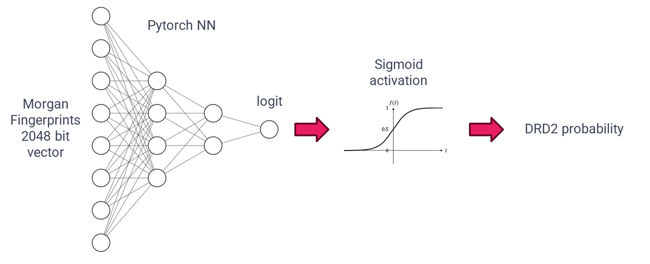
Model architecture
This project develops three feedback models for REINVENT during the scoring stage: the scoring (baseline) model, the comparing (Bradley-Terry) model and the ranking (ListNet) model (Cao et al. 2007)
While they differ in how they return the feedback to REINVENT, they has essentially the same neural network architecture, which is to learn the DRD2 probability.
This aspect is convenient because we would prefer these feedback models to not only offer diverse feedback to REINVENT but they should also be used to infer DRD2 probability of new SMILES quickly.
The figure below shows the simple architecture for learning DRD2 probability, where the Sigmoid activation ensures that the logit is restricted to range [0, 1]
Notes:
Z. Cao, T. Qin, T.-Y. Liu, M.-F. Tsai, and H. Li, “Learning to rank: from pairwise approach to listwise approach,” in Proceedings of the 24th international conference on Machine learning, pp. 129–136, ACM, 2007

Slide 14
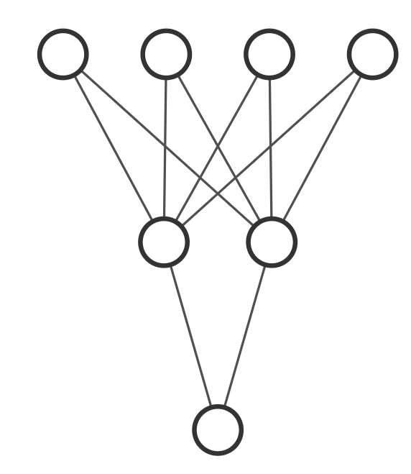
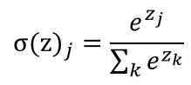
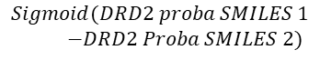
scoring model
comparing model
ranking model
DRD2 probability is often hard to measure directly if the scoring agent is human. This model directly returns DRD2 probability as feedback
Easier for humans to tell which molecule is better. Inspiration: Relative comparison is easier than absolute measure. This model uses the Bradley-Terry formula
Same motivation as comparing model but provides relative preference instead of win-all or take-all approach (better or worse). This model uses the ListNet architecture
SMILES 1
SMILES 1
SMILES 2
SMILES 1
SMILES 2
SMILES 3
DRD2 proba of SMILES 1
DRD2 proba of SMILES 1
DRD2 proba of SMILES 2
DRD2 proba of SMILES 1
DRD2 proba of SMILES 2
DRD2 proba of SMILES 3
Bradley-Terry formula
SOFTMAX FUNCTION
$$Sigmoid(DRD2 proba SMILES 1$$
$−DRD2 Proba SMILES 2)$
14
Probability of SMILES 1 better than SMILES 2
Vector of 3 preference scores

Slide 15
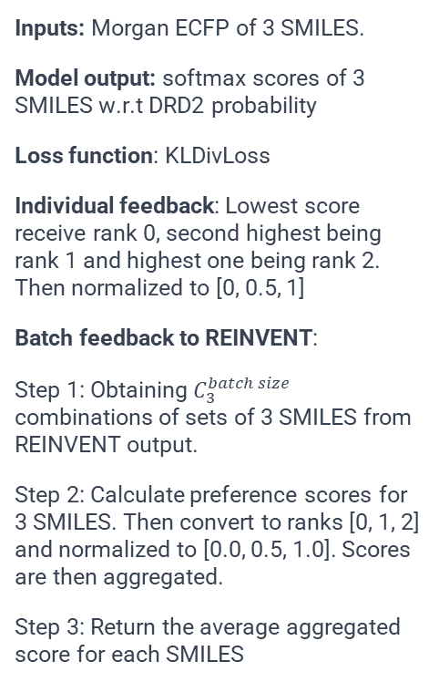
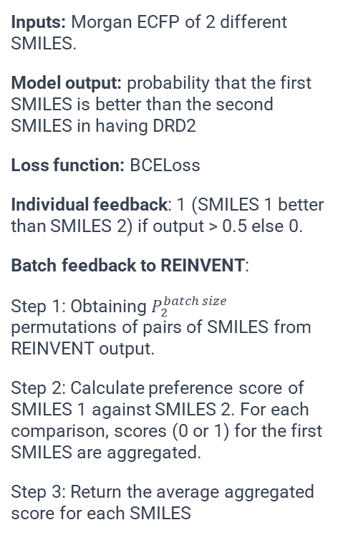
scoring model
comparing model
ranking model
Inputs: Morgan ECFP of 1 single SMILES.
Model output: probability that the SMILES have DRD2
Loss function: BCELoss
Individual feedback: Original output (score between 0 and 1)
Batch feedback to REINVENT:
Simply returning the original output for each SMILES
Inputs: Morgan ECFP of 2 different SMILES.
Model output: probability that the first SMILES is better than the second SMILES in having DRD2
Loss function: BCELoss
Individual feedback: 1 (SMILES 1 better than SMILES 2) if output > 0.5 else 0.
Batch feedback to REINVENT:
Step 1: Obtaining $P_{2}^{batch size}$ permutations of pairs of SMILES from REINVENT output.
Step 2: Calculate preference score of SMILES 1 against SMILES 2. For each comparison, scores (0 or 1) for the first SMILES are aggregated.
Step 3: Return the average aggregated score for each SMILES
Inputs: Morgan ECFP of 3 SMILES.
Model output: softmax scores of 3 SMILES w.r.t DRD2 probability
Loss function: KLDivLoss
Individual feedback: Lowest score receive rank 0, second highest being rank 1 and highest one being rank 2. Then normalized to [0, 0.5, 1]
Batch feedback to REINVENT:
Step 1: Obtaining $C_{3}^{batch size}$ combinations of sets of 3 SMILES from REINVENT output.
Step 2: Calculate preference scores for 3 SMILES. Then convert to ranks [0, 1, 2] and normalized to [0.0, 0.5, 1.0]. Scores are then aggregated.
Step 3: Return the average aggregated score for each SMILES
15

Slide 16
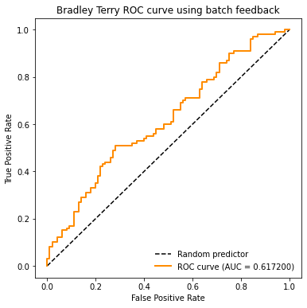

Classification using DRD2 batch feedback or DRD2 probability?
As mentioned earlier, all models learn DRD2 probability, but return different feedbacks to REINVENT
Would there be drastic differences in classification results if we use batch feedback?
Answer is probably NO. ROC curve for classification for batch feedback and DRD2 probability are similar
=> To save computational resources, we use DRD2 probability for classification instead of batch feedback

Slide 17
5. HITL workflow for De-Novo Drug Design

Slide 18
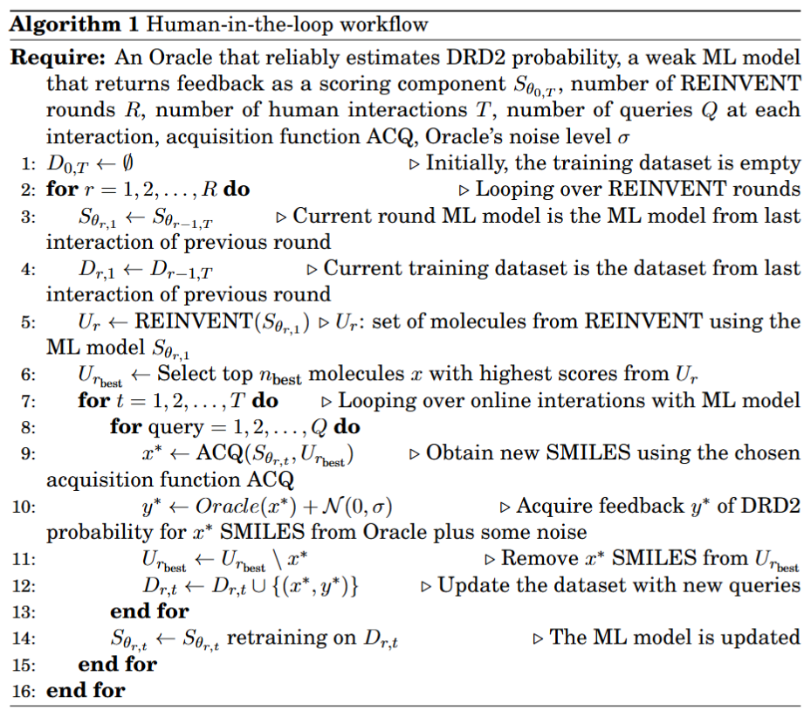
Human-in-the-loop workflow
Workflow inspired by Sundin et al. [2023]
Evaluating score is time-consuming
=> use ML model to act as a surrogate human.
To ensure that ML imitates a human, it should classify DRD2 with low accuracy (around 0.5)
at the beginning.
Settings used in this project are
R = 3 REINVENT rounds
T = 5 HITL interactions
Q = 56 queries
REINVENT's batch size = 64
REINVENT’s optimization steps = 100
Initial training dataset size is 100 SMILES with DRD2 and 100 without DRD2
After 3 REINVENT rounds of 5 iterations, the final training dataset size becomes
200 + 3 x 5 x 56 = 1040 SMILES
for the last ML model.
Notes:
I. Sundin, A. Voronov, H. Xiao, K. Papadopoulos, E. J. Bjerrum, M. Heinonen, A. Pa- tronov, S. Kaski, and O. Engkvist, “Human-in-the-loop assisted de novo molecular design,” ChemRxiv, 2022

Slide 19
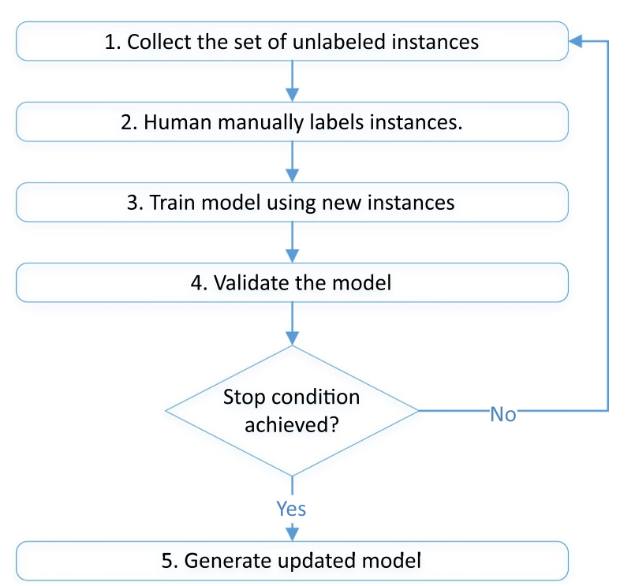
Active learning (AL)
Active learning is semi-supervised learning as it uses both labeled and unlabeled data for training ML model (Tharwat et al. 2023)
New samples get annotated in an iterative process, where an acquisition function choose an unlabelled data, and once labeled by an Oracle, will result in a model accuracy increment
In this project, random, uncertainty and greedy acquisition functions are used to choose most promising generated SMILES
1. Random acquisition selects randomly from the pool of unselected SMILES. This helps introduce diversity in new training molecules.
2. Uncertainty acquisition selects molecules for which the ML model has the least confidence in its prediction
3. Greedy acquisition selects molecules that have the highest predicted DRD2 probabilities based on feedback from ML models
Notes:
A. Tharwat and W. Schenck, “A survey on active learning: State-of-the-art, practical
challenges and research directions,” Mathematics, vol. 11, no. 4, 2023

Slide 20
Molecular descriptor filtering for REINVENT’s generated SMILES
Properties that affect pharmacokinetic (PK) parameters are the molecular descriptors, which are used to characterize the physical, chemical, and structural properties of molecules.
Molecules that bypass these molecular descriptor filters’ threshold are considered to be good candidates as bioactive, efficient drugs
 | Description | Lower threshold | Higher threshold | Known rules
DRD2 probability | Objective to maximize | 0.75 | 1.0 | 0.75 is average DRD2 probability of SMILES actually having DRD2 predicted by Oracle
logP | Filtering | 1.0 | 5.0 | Lipinski's rule of five
Molecule weight | Filtering | 0 | 500.0 | Lipinski's rule of five
Hydrogen bond donors number | Filtering | 0 | 5 | Lipinski's rule of five
Hydrogen bond acceptors number | Filtering | 0 | 10 | Lipinski's rule of five
TPSA | Filtering | 0.0 | 140.0 | Veber et al.
Number of rotatable bonds | Filtering | 0 | 10 | Veber et al.
Number of rings | Filtering | 0 | 7 | Muegge et al.
Notes:
C. A. Lipinski, F. Lombardo, B. W. Dominy, and P. J. Feeney, “Experimental and computational approaches to estimate solubility and permeability in drug discovery and development settings,” Advanced Drug Delivery Reviews, vol. 23, no. 1-3, pp. 3–25, 1997.
Veber, D. F., Johnson, S. R., Cheng, H. Y., Smith, B. R., Ward, K. W., & Kopple, K. D. (2002). Molecular properties that influence the oral bioavailability of drug candidates. Journal of Medicinal Chemistry, 45(12), 2615-2623. doi:10.1021/jm020017n
Muegge, I., Heald, S. L., & Brittelli, D. (2001). Simple selection criteria for drug-like chemical matter. Journal of Medicinal Chemistry, 44(12), 1841-1846. doi:10.1021/jm015507e

Slide 21
Metric scores for REINVENT’s generated SMILES besides DRD2 probability
As per objectives of de novo molecular design, the novelty score, diversity score, synthetic accessibility (SA) score, and quantitative estimate of drug-likeness (QED) score are important metrics to assess the quality of generated molecules.
 | Definition | Good lower threshold | Good upper threshold | Known rules
Novelty score [1] | Fraction of the generated molecules not present in the training set. Range [0, 1]. The higher the better | Possibly more than 0.95 | 1.00 | Polykovskiy et al.
Diversity score [2] | Internal chemical diversity within the generated molecules set. Range [0, 1]. The higher the better. | Possibly more than 0.7 | 1.00 | Benhenda et al.
Synthetic assessibility (SA) score | How easily a molecule can be synthesized. Range [1, 10]. The lower, the better | 1.0 | 3.0 | Ertl & Schuffenhauer
Quantitative estimate of drug-likeness (QED) score | Composite metric that evaluates the drug-likeness of a compound based on several molecular properties. Range [0, 1]. The higher the better | 0.5 | 1.0 | Bickerton et al.
Notes:
D. Polykovskiy, A. Zhebrak, B. Sanchez-Lengeling, S. Golovanov, O. Tatanov, S. Belyaev, R. Kurbanov, A. Artamonov, V. Aladinskiy, M. Veselov, A. Kadurin, S. Johansson, H. Chen, S. Nikolenko, A. Aspuru-Guzik, and A. Zhavoronkov, “Molecular sets (moses): A benchmarking platform for molecular generation models,” arXiv preprint arXiv:1811.12823, 2018.
M. Benhenda, “Chemgan challenge for drug discovery: can ai reproduce natural chemical diversity?,” arXiv preprint arXiv:1708.08227, 2017.26
Ertl, P., & Schuffenhauer, A. (2009). Estimation of synthetic accessibility score of drug-like molecules based on molecular complexity and fragment contributions. Journal of Cheminformatics, 1, 8. doi:10.1186/1758-2946-1-8
Bickerton, G. R., Paolini, G. V., Besnard, J., Muresan, S., & Hopkins, A. L. (2012). Quantifying the chemical beauty of drugs. Nature Chemistry, 4, 90–98. doi:10.1038/nchem.1243

Slide 22
6. Results

Slide 23
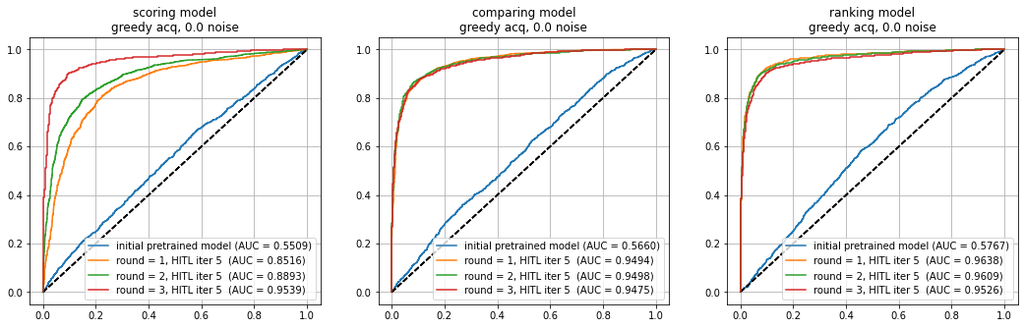
ROC curve evolution after 3 REINVENT rounds
Initially, the pre-trained models show relatively low AUC values, which imitate a human component, as they have limited ability to tell apart molecules with and without DRD2. However, with each round of 5 HITL iterations, there is a considerable improvement in AUC values for all models

Slide 24
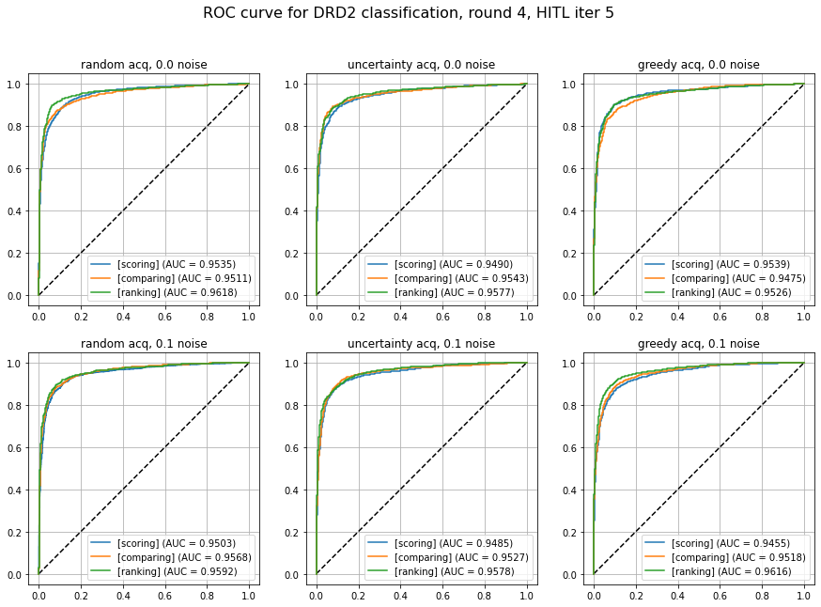
ROC curve comparison between running cases
Across all running cases, the AUC values indicate that all models perform well as expected.
The ranking model consistently achieves highest AUC values, followed closely by the comparing model and the scoring model.

Slide 25
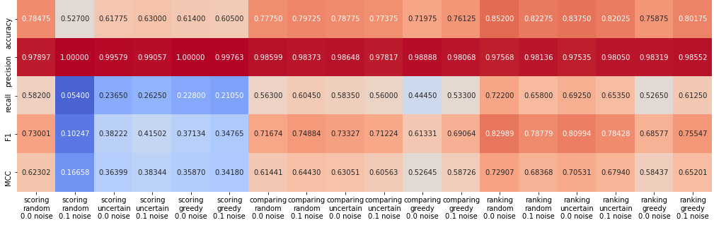
Feedback model DRD2 classification metrics
Best configuration on classifying DRD2 presence
Testing dataset: 1000 SMILES with DRD2 and 1000 without DRD2.
Most models have high precision, but unhelpful because the positive case (DRD2) is much rarer during the training process
=> We should focus more on recall and MCC score
The ranking model consistently has higher recall than comparing model, which in turn has higher recall than scoring model.
Comparing and ranking molecules deliver better classification result than directly learning the DRD2 probability.
Diverse molecules during training can help improve MCC score

Slide 26
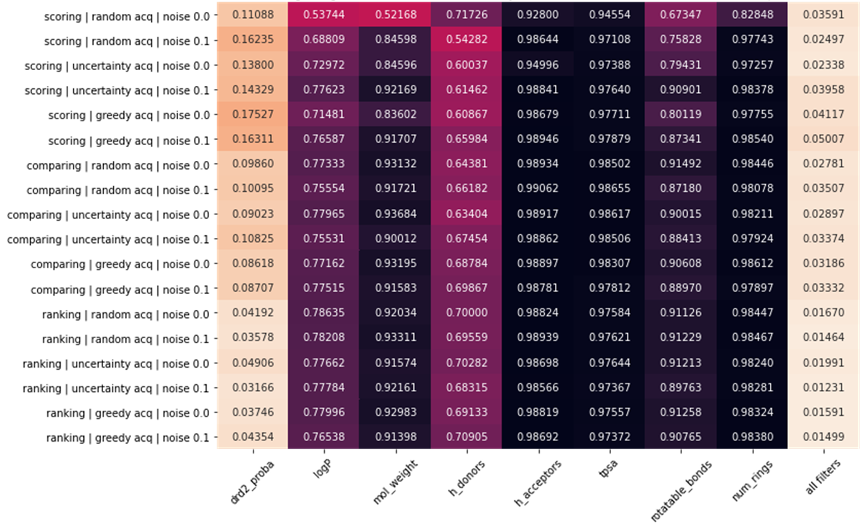
Percentage of generated SMILES that satisfy each filter at all REINVENT rounds
Most molecules generated by REINVENT already satisfy the filters except logP and the number of hydrogen
bond donors
The scoring model is most capable of generating molecules with DRD2, followed by the comparing model and lastly by the ranking model => major advantage of the scoring model

Slide 27
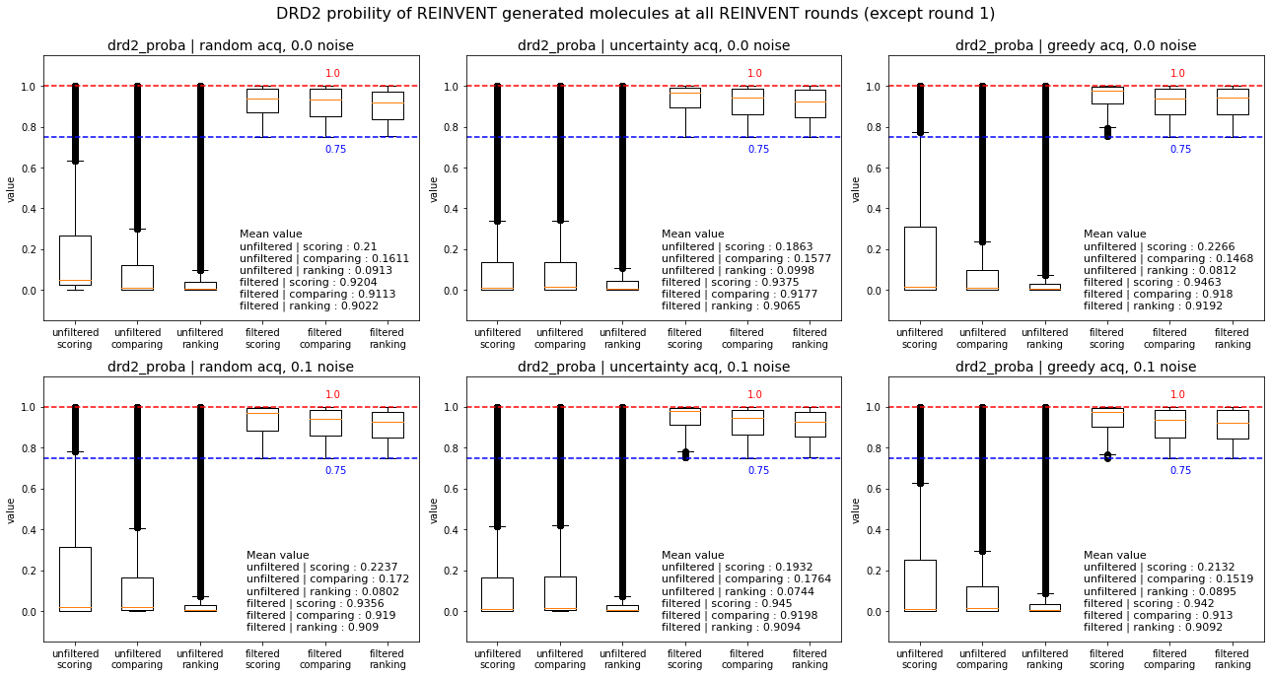
DRD2 probability of REINVENT’s generated molecules for all rounds
For generating molecules with highest DRD2 presence, the scoring model is the best, followed by the comparing model and lastly the ranking model. This is true for both filtered and unfitered generated SMILES

Slide 28
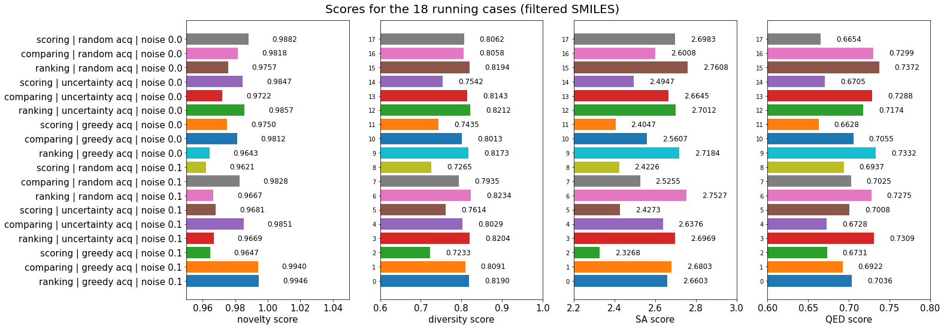
Metric scores comparison between all running cases for filtered SMILES
Novelty score: it is often nearly equal for 3 models, probably comparing model frequently has highest novelty score.
Diversity score: ranking model consistently outperforms comparing model, which in turns is better than the scoring model.
SA score seems inversely proportional to the diversity score => scoring model has best SA score, followed by comparing model and lastly ranking model.
QED score: ranking model consistently outperforms comparing model, which in turns better than the scoring model.

Slide 29
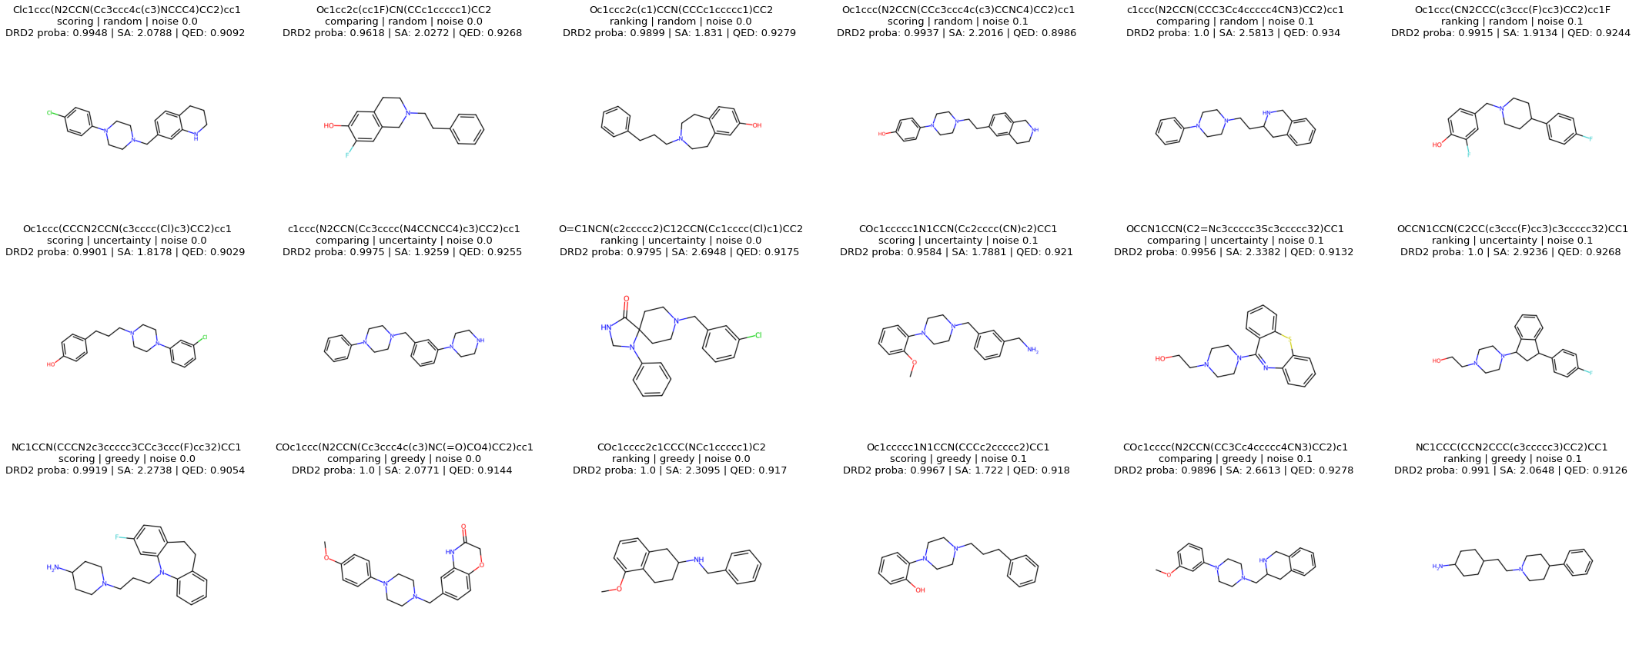
Example of best molecules for each running case
molecules produced by the scoring model have simple structures with few branches and fewer functional groups
comparing and ranking model shows greater structural complexity and diversity with different ring systems
and functional groups. They maintain a balance between drug-likeness, diversity, and novelty

Slide 30
7. Discussions

Slide 31
Comparison of feedback models
 | Scoring model | Comparing model | Ranking model
ML model with highest MCC on DRD2 classification | 3 | 2 | 1
Generate molecules that are likely to pass molecular descriptors | 3 | 2 | 1
Generate molecules that are likely to pass DRD2 probability threshold | 1 | 2 | 3
Generate molecules that maximize DRD2 probability | 1 | 2 | 3
Generate molecules that maximize novelty score | 2 | 1 | 3
Generate molecules that maximize diversity score | 3 | 2 | 1
Generate molecules that minimize SA score | 1 | 2 | 3
Generate molecules that maximize QED score | 3 | 2 | 1
Rank 1 is best and Rank 3 is worst
The scoring model shows the best performance in generating molecules that maximize SA score, DRD2 probability and pass the DRD2 probability threshold.
The comparing model keeps a balance between scoring and ranking models, performing moderately well across all criteria, particularly in generating molecules with high novelty score.
The ranking model consistently excels in DRD2 classification with high MCC score, passing molecular descriptors, maximizing molecule internal diversity, and achieving high QED scores.

Slide 32
Comparison of acquisition functions
 | random | uncertainty | greedy
ML model with highest MCC on DRD2 classification | 1 | 2 | 3
Generate molecules that are likely to pass molecular descriptors | 3 | 2 | 1
Generate molecules that are likely to pass DRD2 probability threshold | 3 | 2 | 1
Generate molecules that maximize DRD2 probability | 3 | 2 | 1
Generate molecules that maximize novelty score | 1 | 2 | 3
Generate molecules that maximize diversity score | 1 | 2 | 3
Generate molecules that minimize SA score | 3 | 2 | 1
Generate molecules that maximize QED score | 1 | 2 | 3
Rank 1 is best and Rank 3 is worst
Random acquisition highest novelty and diversity score, but the lowest for producing molecules that would pass molecular descriptors and DRD2 probability thresholds
Uncertainty acquisition balances performance by placing second in most categories.
Greedy acquisition is the best at generating molecules that maximize DRD2 probability and minimizing SA scores, but worst in terms of novelty and diversity

Slide 33
Comparison of labelling noise
 | noise 0.0 | noise 0.1
ML model with highest MCC on DRD2 classification | uncertain | uncertain
Generate molecules that are likely to pass molecular descriptors | 2 | 1
Generate molecules that are likely to pass DRD2 probability threshold | uncertain | uncertain
Generate molecules that maximize DRD2 probability | 1 | 2
Generate molecules that maximize novelty score | 2 | 1
Generate molecules that maximize diversity score | 2 | 1
Generate molecules that minimize SA score | 1 | 2
Generate molecules that maximize QED score | 2 | 1
Rank 1 is better than Rank 2
Models with a noise of 0.1 regularly outperforms noise 0.0 in terms of producing molecules that pass molecular descriptors while maximizing novelty, diversity, and QED scores.
Models with noise 0.0 outperform the other in terms of producing molecules that maximize DRD2 probability while minimizing SA scores.
Which noise is better for passing DRD2 probability thresholds and getting higher MCC in DRD2 classification remain questionable.

Slide 34
8. Conclusions
*Note: these conclusions are based on the last REINVENT round and also from all REINVENT rounds. Results could vary with different number of HITL iterations, seed number or number of queries. Nonetheless, these conclusions can be roughly reliable, since experiments been repeated 2 times with different REINVENT optimization steps and number of queries.

Slide 35
Key takeaway: feedback mechanism, acquisition function and the noise in labelling offer robust customization in de-novo molecular design to target different aspects of molecules
=> Users can change them to fit specific molecules generation objectives
💡 To focus on generating molecules that directly targets chemical properties like DRD2 and easiest synthesizability, the scoring model + greedy acquisition function + no labelling noise is the best option.
💡 To focus on generating novel molecules while keeping a balance across all metrics, the comparing model + uncertainty acquisition function is the best option.
💡 To focus on generating diverse and drug-like molecules as much as possible, the ranking model + random acquisition + labelling noise is the best option.
🤔 Future research could refine these feedback models or introduce new feedback mechanisms, such as binary preference (yes/no liking given a SMILES), multiple rankings (4-5 SMILES ranking), or even multiple binary preference (yes/no liking given k-criteria given a SMILES)

Slide 36
References
[1] V. Gillet, De Novo Molecular Design, vol. 4. 2000
[2] H.-H. Hsu, C.-H. Huang, and S.-T. Lin, “New data structure for computational molecular design with atomic or fragment resolution,” Journal of Chemical Information and Modeling, vol. 59, no. 8, pp. 3325–3335, 2019
[3] A. Tharwat and W. Schenck, “A survey on active learning: State-of-the-art, practical challenges and research directions,” Mathematics, vol. 11, no. 4, 2023.
[4] T. Kaufmann, P. Weng, V. Bengs, and E. Hüllermeier, “A survey of reinforcement learning from human feedback,” 2023.
[5] S. Takeda, H. Kaneko, and K. Funatsu, “Chemical-space-based de novo design method to generate drug-like molecules,” Journal of Chemical Information and Modeling, vol. 56, no. 9, pp. 1667–1681, 2016.
[6] S. K. Dhanda, D. Singla, A. Mondal, and G. Raghava, “Drugmint: a webserver for predicting and designing of drug-like molecules,” Biology Direct, vol. 8, p. 28, 2013.
[7] Y. Liang, R. Zhang, L. Zhang, and P. Xie, “Drugchat: Towards enabling chatgpt-like capabilities on drug molecule graphs,” arXiv preprint arXiv:2309.03907, 2023.
[8] E. Mosqueira-Rey, E. Hernández-Pereira, D. Alonso-Ríos, J. Bobes-Bascarán, and Fernández-Leal, “Human-in-the-loop machine learning: a state of the art,” Artificial Intelligence Review, vol. 56, 08 2022.
[9] W. Zhang, M. Lei, Q. Wen, D. Zhang, G. Qin, J. Zhou, and L. Chen, “Dopamine receptor D2 regulates glua1-containing ampa receptor trafficking and central sensitization through the pi3k signaling pathway in a male rat model of chronic migraine,” Journal of Headache and Pain, vol. 23, no. 1, p. 45, 2022
[10] T. Blaschke, J. Arús-Pous, H. Chen, C. Margreitter, C. Tyrchan, O. Engkvist, K. Pa- padopoulos, and A. Patronov, “Reinvent 2.0: An ai tool for de novo drug design,” Journal of Chemical Information and Modeling, vol. 60, no. 9, pp. 4423–4433, 2020
[11] Z. Cao, T. Qin, T.-Y. Liu, M.-F. Tsai, and H. Li, “Learning to rank: from pairwise approach to listwise approach,” in Proceedings of the 24th international conference on Machine learning, pp. 129–136, ACM, 2007
[12] I. Sundin, A. Voronov, H. Xiao, K. Papadopoulos, E. J. Bjerrum, M. Heinonen, A. Pa- tronov, S. Kaski, and O. Engkvist, “Human-in-the-loop assisted de novo molecular design,” ChemRxiv, 2022
[13] C. A. Lipinski, F. Lombardo, B. W. Dominy, and P. J. Feeney, “Experimental and computational approaches to estimate solubility and permeability in drug discovery and development settings,” Advanced Drug Delivery Reviews, vol. 23, no. 1-3, pp. 3–25, 1997.
[14] Veber, D. F., Johnson, S. R., Cheng, H. Y., Smith, B. R., Ward, K. W., & Kopple, K. D. (2002). Molecular properties that influence the oral bioavailability of drug candidates. Journal of Medicinal Chemistry, 45(12), 2615-2623. doi:10.1021/jm020017n
[15] Muegge, I., Heald, S. L., & Brittelli, D. (2001). Simple selection criteria for drug-like chemical matter. Journal of Medicinal Chemistry, 44(12), 1841-1846. doi:10.1021/jm015507e
[16] D. Polykovskiy, A. Zhebrak, B. Sanchez-Lengeling, S. Golovanov, O. Tatanov, S. Belyaev, R. Kurbanov, A. Artamonov, V. Aladinskiy, M. Veselov, A. Kadurin, S. Johansson, H. Chen, S. Nikolenko, A. Aspuru-Guzik, and A. Zhavoronkov, “Molecular sets (moses): A benchmarking platform for molecular generation models,” arXiv preprint arXiv:1811.12823, 2018.
[17] M. Benhenda, “Chemgan challenge for drug discovery: can ai reproduce natural chemical diversity?,” arXiv preprint arXiv:1708.08227, 2017.26
[18] Ertl, P., & Schuffenhauer, A. (2009). Estimation of synthetic accessibility score of drug-like molecules based on molecular complexity and fragment contributions. Journal of Cheminformatics, 1, 8. doi:10.1186/1758-2946-1-8
[19] Bickerton, G. R., Paolini, G. V., Besnard, J., Muresan, S., & Hopkins, A. L. (2012). Quantifying the chemical beauty of drugs. Nature Chemistry, 4, 90–98. doi:10.1038/nchem.1243

Slide 37
Thank for for your attention
Contact info:
binh.nguyen@aalto.fi
If you have inquiries about this research project
Project source code is at:
https://github.com/SpringNuance/Human-In-The-Loop-De-Novo-Molecular-Design
Question and Answers

